Slide 1
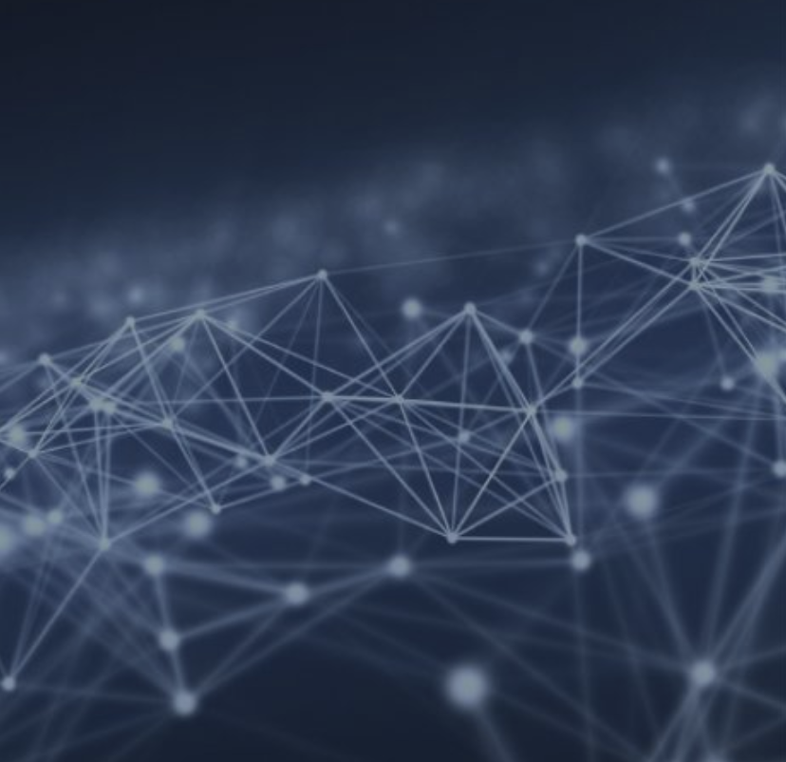

The case for storing Graph Data in Semantic Databases
Feb 2023
Ver 2.0.3
Grant Steinfeld
Lead Engineer, Prudential Financial
https://github.com/Grant-Steinfeld

Slide 2

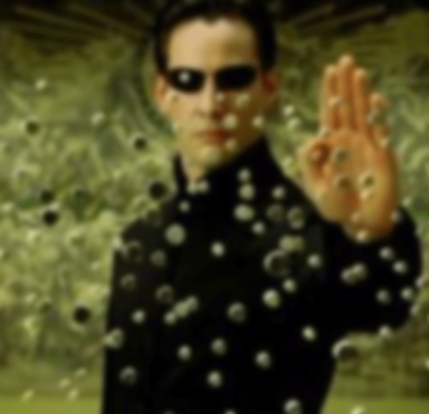
Graph Data
Points or Vertices
Edges or Relationships
Notes:
Botanist
Fast
Inmotion
Lots of it

Slide 3
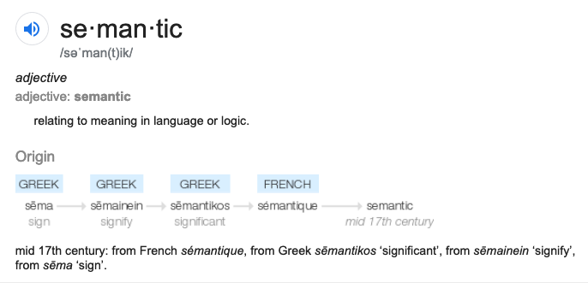
Semantic
MEANING | KNOWLEDGE

Slide 4
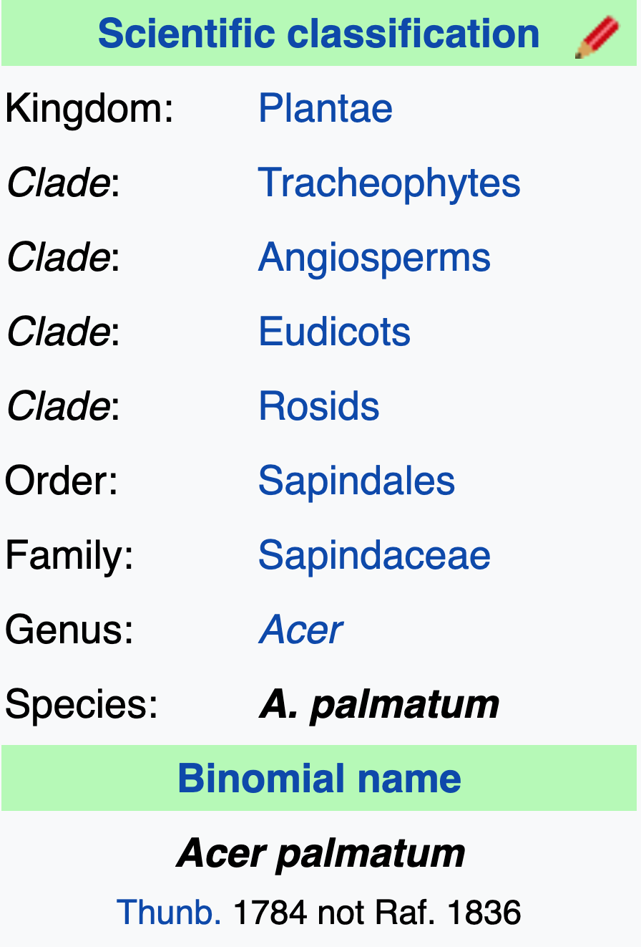

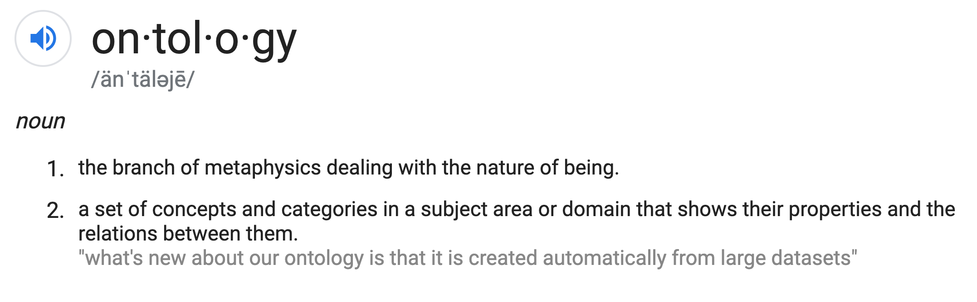
Ontology

Slide 5
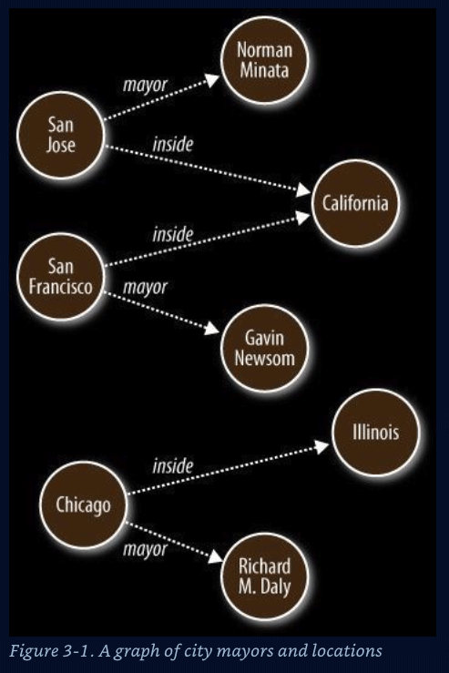
Vertices(data) and edges of a Semantic Graph
Nodes – Data Entities ( nouns )
S O
Edges – Relationships ( verbs )
P
Graph algorithms
Reasoning ( Decisions )
Inferences
Shortest path
Cliques / Neighborliness
Interconnected ness
Patterns
Notes:
Represent data that is hard to store in columnar and row format

Slide 6
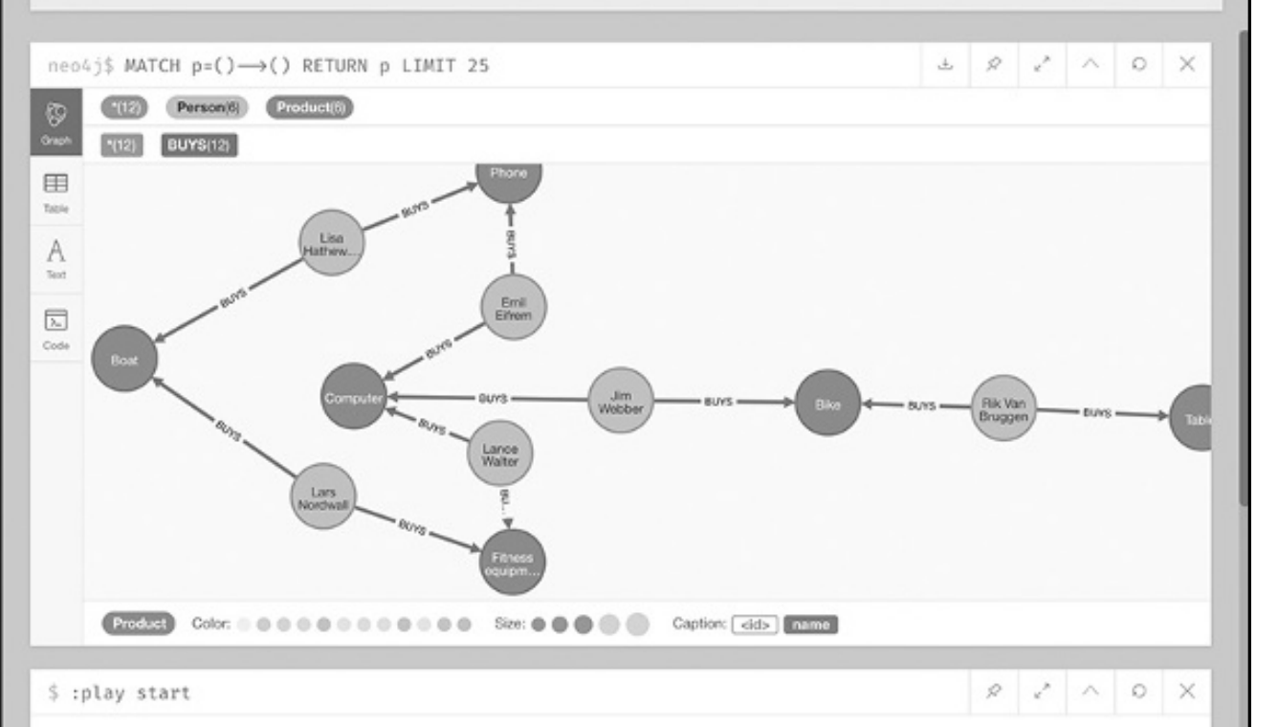

Who bought computers and bikes and phones
Notes:
A data structure to who bought what – Neo4j visual tool

Slide 7
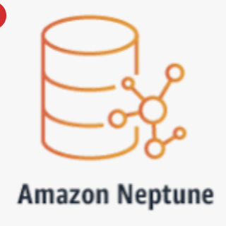
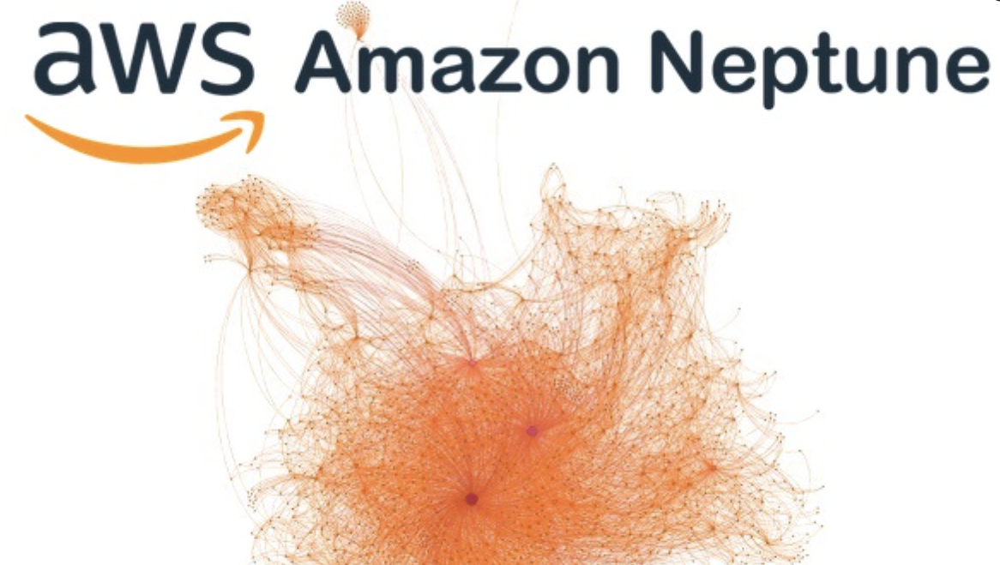
Amazon Graph Database offering in AWS Cloud

Slide 8
RDF – sums it up
Resource Description Framework
Web model/standard for data interchange on the WWW
RDF has features that facilitate data merging even if the underlying schemas differ.
Supports `schema` evolution over time without requiring all the data consumers to be changed

Slide 9
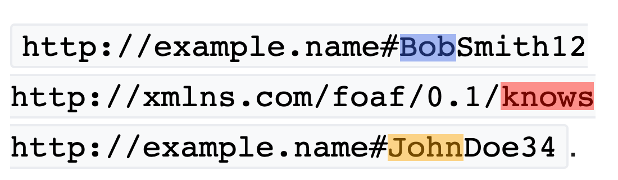
RDF Triples
SUBJECT
PREDICATE
OBJECT
Notes:
RDF extends the linking structure of the Web to use URIs to name the relationship between things as well as the two ends of the link

Slide 10
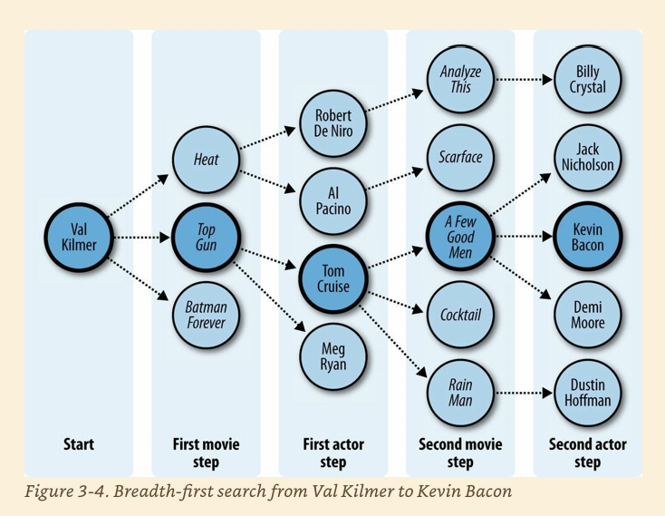
FOAF Six degrees of seperation
Notes:
﻿Six Degrees of Kevin Bacon A good example of the breadth-first search algorithm is the trivia game “Six Degrees of Kevin Bacon,” where one player names a film actor, and the other player tries to connect that actor to the actor Kevin Bacon through the shortest path of movies and co-stars. For instance, one answer for the actor Val Kilmer would be that Val Kilmer starred in Top Gun with Tom Cruise, and Tom Cruise starred in A Few Good Men with Kevin Bacon, giving a path of length 2 because two movies had to be traversed.
Evans, Colin. Programming the Semantic Web: Build Flexible Applications with Graph Data (p. 51). O'Reilly Media. Kindle Edition.

Slide 11
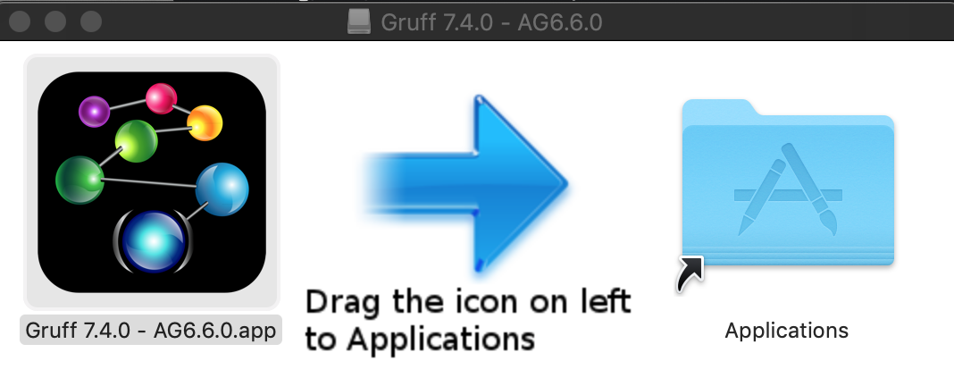
Demo Gruff
Notes:
Show pizza in Web View - Add Triples … then display sample nodes

Slide 12
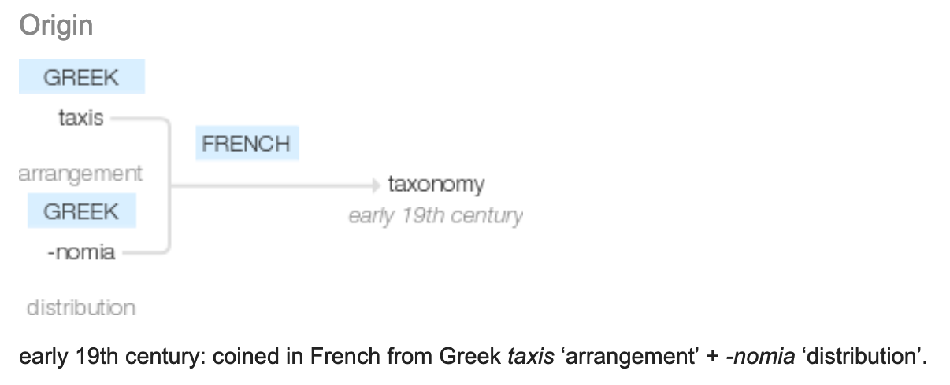
Taxonomy
Notes:
ONTOLOGY

Slide 13

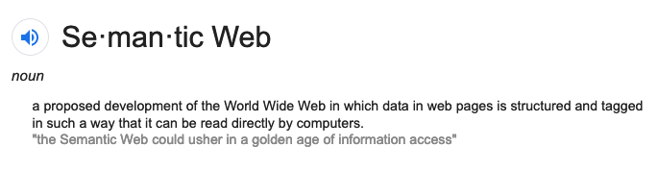
Golden age of Information Access

Slide 14
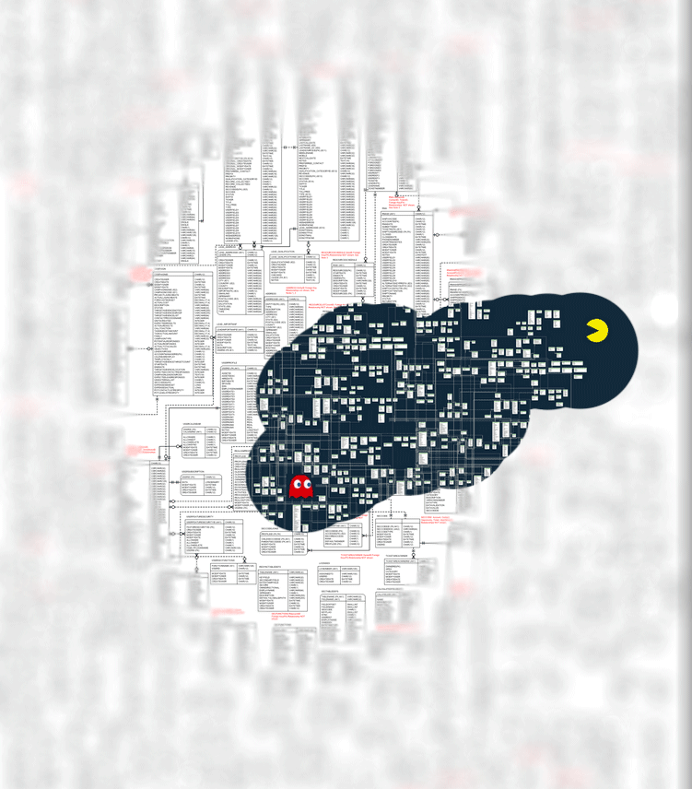
Inference New Ideas + Hypotheses Patterns
Notes:
LOOKING FOR
FINDING PATTERNS

Slide 15
Why?
Data
Volume huge
ETL
Retrieval / Query

Slide 16
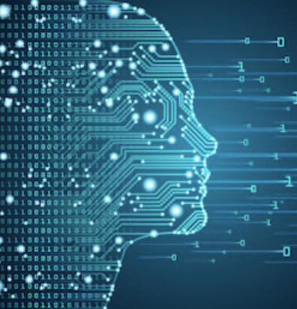
Web – worlds biggest `sensor`
Web pages – Human readable – unstructured
What is machine readable? – structured
Big Fast Moving Data – overwhelming TL;DR;
Notes:
How to Derive Structure from Unstructured Web
Google search – good for humans

Slide 17
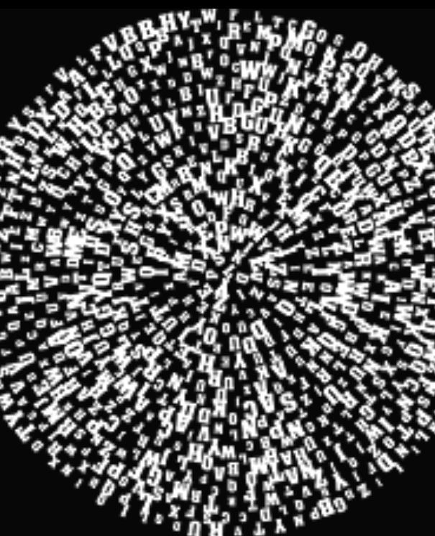
Triple `Soups`
Bowl -> Triple Store – Semantic Graph DB
`Alphabet soup` -> SPO OPS POS SOP POS
Merge ?
Notes:
Merge Using this simple model, it allows structured and semi-structured data to be mixed, exposed, and shared across different applications.

Slide 18
Flavors
N-Triples
RDF
aRDF

Slide 19
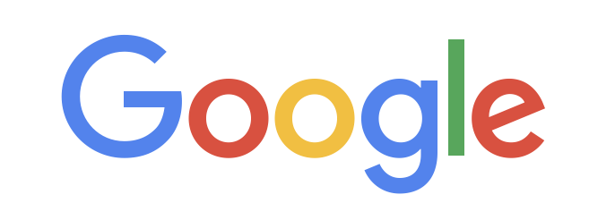
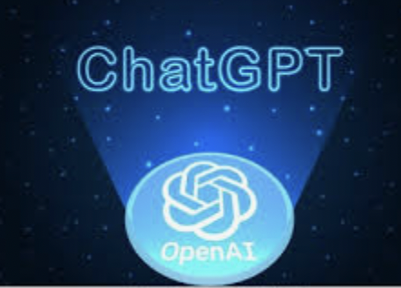
Semantic/Graph database top ranked
Neo4j
AmazonNeptune
AllegroGraph
Cosmos DB
"top 6 graph databases"
1. Neo4j
2. Amazon Neptune
3. OrientDB
4. ArangoDB
5. FlockDB
6. AllegroGraph
Notes:
Neo4j ( AWS Marketplace, SAAS Azure )
Amazon Neptune on AWS
Serverless graph database designed for superior scalability and availability
AllegroGraph – Docker standalone or VM image on all major Cloud offerings
Azure Cosmos DB for Apache Gremlin on Azure

Slide 20
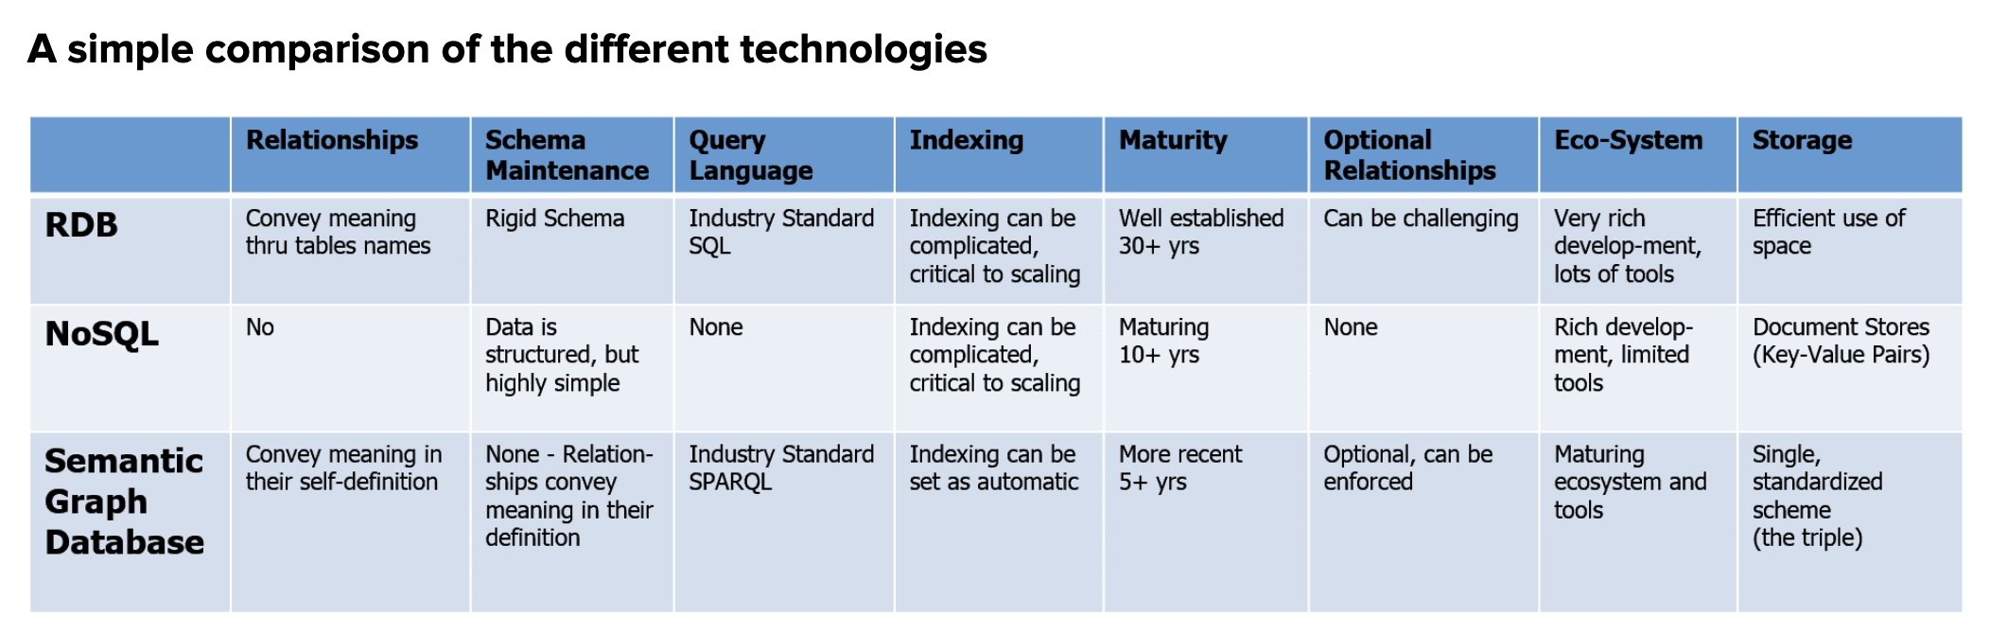
Comparison
RDBs ( MySQL, MSSQL, DB2 etc )
NoSQL ( CouchDB, MongoDB, DocumentDB, etc )
Semantic Graph DB ( Neo4j, allegroGraph(agraph) )
Notes:
How does Graph square up wrt Relational DBMS and / or NoSQL stores?

Slide 21
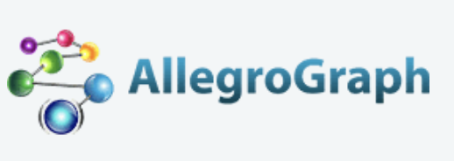
Overview
Unlike traditional relational databases or more recently developed NoSQL databases or simple property graphs,
Franz’s AllegroGraph employs a combination of semantic graph (RDF, OWL, SPARQL) and document (JSON, JSON-LD) technologies that process data with contextual and conceptual intelligence.
AllegroGraph with FedShard™ is able to run queries of unprecedented complexity to support predictive analytics that help companies make better, real-time decisions.
AllegroGraph is designed to integrate with large corporate databases to build Knowledge Graphs for better business insights.

Slide 22
Popular Use Cases
Social Networks - FOAF
Bio-Informatics
Music
Portfolio Analysis
Fraud detection – AML
…
Financial/Banking industry use cases
Notes:
Dodd-Frank Wall Street Reform
Mortgage and Loan rules and auditability of transactions
Credit Default Swaps ownership reporting
Know Your Customer requirements
Sarbanes-Oxley
Business and Legal Entity tracking requirements
Computation of derivatives risk
Basal III international regulations
Foreign corrupt Practices Act
UK Bribery Act
Fraud Detection
Personal Information security
New regulations on transfer pricing

Slide 23
3rd Party Integration
Cloudera
Anaconda
ML/Data mining
NoSQL Ecosystem
MongoDB integration
Solr Text indexing
Financial/Banking industry use cases
Notes:
Dodd-Frank Wall Street Reform
Mortgage and Loan rules and auditability of transactions
Credit Default Swaps ownership reporting
Know Your Customer requirements
Sarbanes-Oxley
Business and Legal Entity tracking requirements
Computation of derivatives risk
Basal III international regulations
Foreign corrupt Practices Act
UK Bribery Act
Fraud Detection
Personal Information security
New regulations on transfer pricing

Slide 24
Use cases for semantic / graph
Social Networks - FOAF
Bio-Informatics
Music
Portfolio Analysis
Fraud detection – AML
Notes:
AML anti money laudering – human trafficking, illegal arms dealers,

Slide 25
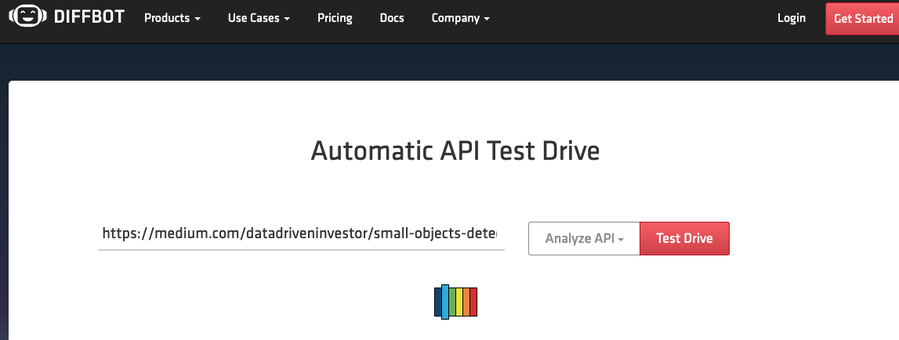
Extraction – demo 1

Slide 26
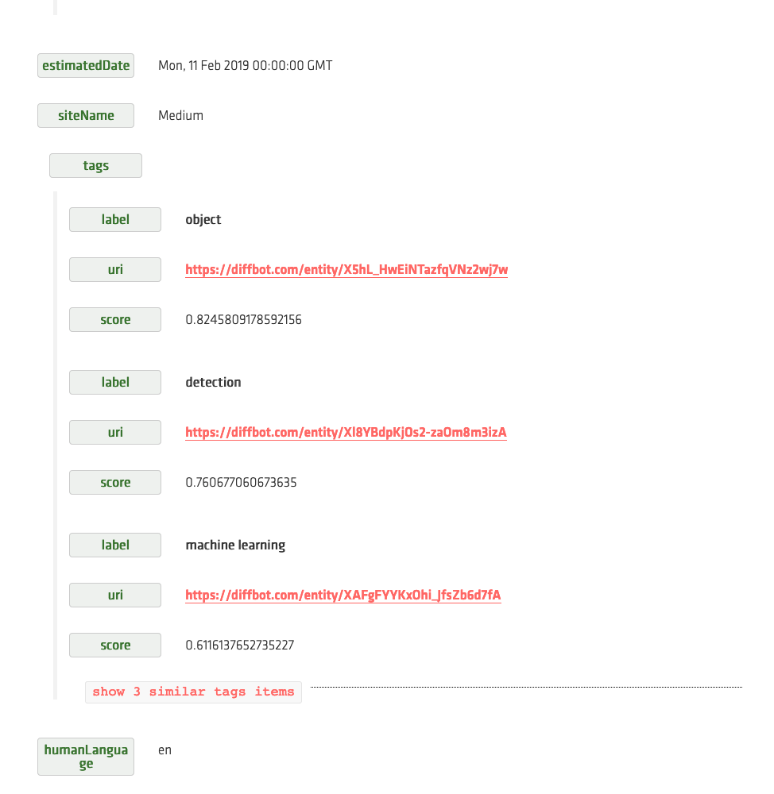
Extraction

Slide 27
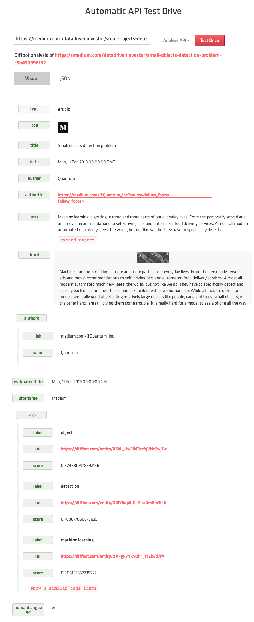

Slide 28
Docker version of Agraph https://franz.com/agraph/docker/

Slide 29

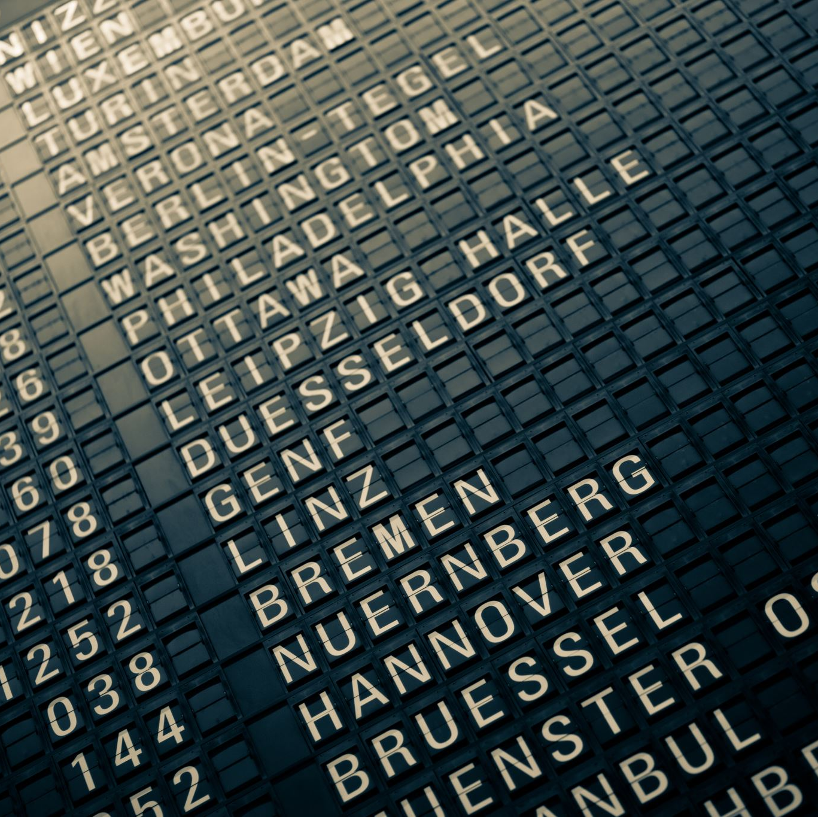

Thank you!!
https://github.com/Grant-Steinfeld/
@gsteinfeld

Slide 30
Resources
Evans, Colin. Programming the Semantic Web: Build Flexible Applications with Graph Data ( book on Amazon )
AllegroGraph (agraph) DB homepage, Franz Inc. https://franz.com/
N-TRIPLES spec - http://www.w3.org/TR/rdf-testcases/#ntriples.
Blog - Ontology and Data Science - Favio Vaquez

Slide 31
Resources (2)
Semantic Graphs: What they are and Why You Should Care ( Blog by David Vandegrift )
Dbpedia Global and Unified Access to Knowledge Graphs ( core engine Wikipedia )
Wikimedia / Commons
Schema.org – discover common and standard labels (Predicates (P))

Slide 32
Resources (3)
Ontology Completion with Graph-Based Machine Learning: A Comprehensive Evaluation (Journal article, December 2022 by Sebastian Mežnar and others )
Semantic similarity and machine learning with ontologies ( Journal article 13 October 2020 by Maxat Kulmanov, Fatima Zohra Smaili, Xin Gao, Robert Hoehndorf)
Briefings in Bioinformatics, Volume 22, Issue 4, July 2021, bbaa199, https://doi.org/10.1093/bib/bbaa199
AWS Neptune – The Good, The Bad, and the Ugly
Discover other Semantic / Graph Databases

